Slide 1

Demystifying Special Needs Trusts

Slide 2


Not All Trusts Are Special Needs Trusts
Many Kinds of Trusts for Different Purposes
Reduce estate taxes
Preserve family wealth
Transfer or hold real estate
Spendthrift trusts
Protect minor children & young adults
Protect in the event of a divorce
Protect in the event of a re-marriage
Nursing home & elder planning
Almost all of these trusts will jeopardize Government Benefits

Slide 3


All Trust Have Three Main Actors
Settlor or Grantor
Beneficiary
Trustee

Slide 4
Special Needs Trusts
Funds are not counted as a resource for purposes of benefits
No limitation on the amount which can be deposited at one time
Funds can only be used for the beneficiary
Funds cannot be used for food, clothing and shelter (Medicaid)
Funds cannot be used for shelter (SSI)
Funds can be used for therapies, trips, recreation, supports, transportation, or almost anything else not covered by the government

Slide 5
Two Types of Special Needs Trusts
Third Party
“Supplemental Benefits Trust”
First Party
“Payback” Trust
“OBRA 93” Trust
“(d)(4)(A)” Trust

Slide 6
Third Party Trust
Holds funds belonging to someone other than the individual with the disability
There is no payback requirement
At the end of the beneficiary's life, the leftover funds are distributed to wherever the parents decide
Less regulatory oversight
Usually part of a comprehensive estate plan

Slide 7
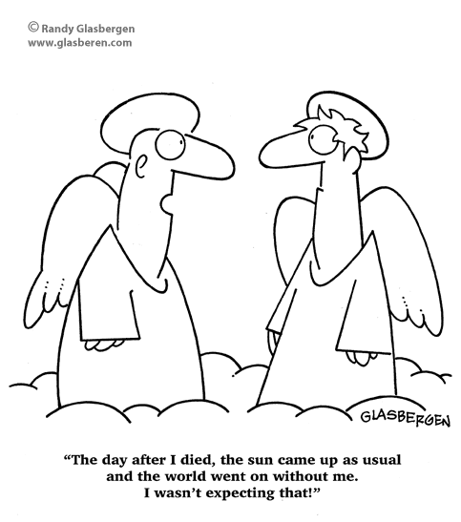

Accepting the Inevitable

Slide 8


Estate Planning for Families with Special Needs
A comprehensive estate plan will include the following documents:
Will
Durable Power of Attorney
Living Will
Special Needs Trust
In some cases additional documents will be recommended to minimize estate taxes liability

Slide 9


Third Party Special Needs Trusts Are Usually Funded Through
Will / Estate Plan
Life Insurance
401(K)
Gifts from Parents
Gifts from others
Bequests from others

Slide 10
Three “Methods” of Estate Planning
Do Nothing
Give it all to the Other Kids
Special Needs Trust

Slide 11
What do Parents Need to Do? (Preparing for When I’m gone)
Name successor guardian in Will
Name successor trustee in Special Needs Trust
Consider appointing co-guardian during parents’ lifetime
Consider co-fiduciaries versus successor-fiduciaries
Do you want the guardian and trustee to be the same or different people?
Is a corporate fiduciary right for your circumstances?

Slide 12
Picking the “Right” Successor
Factors to Consider:
Age
Emotional Readiness
Life’s circumstances
Involvement
Diligence
Strength of personality
Willingness to ask for help

Slide 13
Good Qualities for Successor
Compassion and Patience
Willingness
Able to get along with others
Responsiveness
Reasonably good a record keeping
Gets stuff done (“GSD”)
Willingness to ask for help
Get involved

Slide 14
Naming a Successor or Co-Trustee
Typically no need for court involvement
Nominate in Will or Trust Agreement
Age and Wisdom an important Factor
Usefulness of a corporate / institutional trustee
Appointment of a Trust Protector

Slide 15
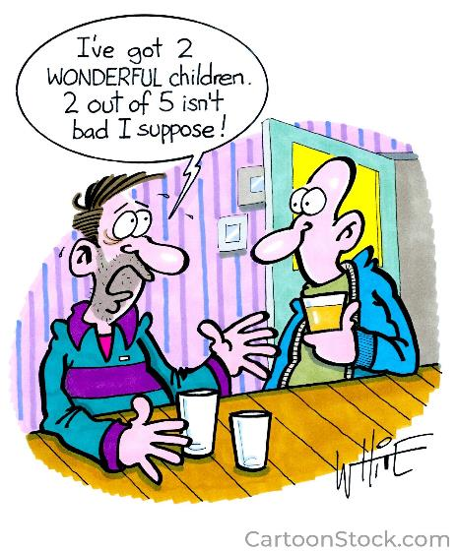
Picking the “Right” Successor

Slide 16
What if I have no one?
Corporate Fiduciary / Community Trust Organization
PLAN – New Jersey

Slide 17
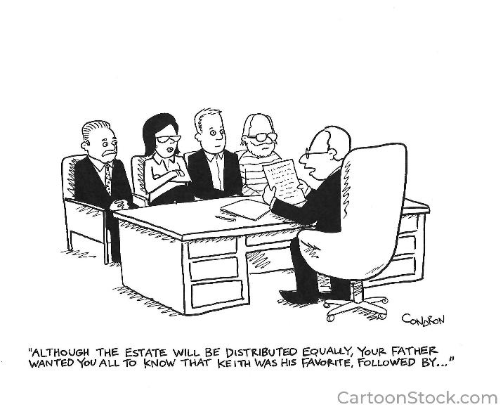
What if I Have More than One?

Slide 18
First Party Trust
Holds funds belonging to the individual with a disability
At the death of person with a disability, the funds must first satisfy any Medicaid lien
DDD can get in on the action too
New Jersey regulations require, among other things:
Annual accountings
45 day notice prior to any expenditure greater than $5,000
More Regulatory Oversight

Slide 19


First Party Trusts Are Usually Funded Through
Lawsuit / Personal Injury Settlement
Improperly Received Inheritance
Accumulated resources before anyone knew of a need for the trust
This type of trust often requires Court approval

Slide 20


Spending The Money
Must be for the person with a disability
Cannot jeopardize Government Assistance Benefits
Cannot be for housing
Generally can spend money on anything needed or wanted as long as it’s not provided or available from the government or insurance

Slide 21
First Party Trust v. Third Party Trust
First Party
Money Comes from the Person with a Disability
Government Payback Requirements
Regular Accountings to Medicaid
Notice Requirement on Disbursements over $5000
More Government Oversight
Third Party
Money Comes from someone OTHER than the Person with a Disability
No Government Payback
Less formal or no accounting requirements (unless on a redetermination)
No Notice requirements on Disbursements
Less Government Oversight

Slide 22

https://savewithable.com/nj/home.html

Slide 23


Recent Changes to ABLE Act
Annual Contribution Limit Remains at $19,000 / year
Previously onset must be before age 26
As of January 1, 2026, age of onset must be before 46.
ABLE-to-Work is now permanent:
Those who work can contribute up to $15,060
Does not apply if you have contributions to qualified retirement plan

Slide 24

What Can Funds In An ABLE Account Be Used For?
Qualified expenses including:
Housing
Education
Transportation
health aides
employment supports
therapies and similar expenses

Slide 25
Benefits of ABLE Accounts
Funds saved in an ABLE account do NOT affect Medicaid eligibility
Funds saved in an ABLE account up to $100,000 will NOT affect SSI eligibility
Funds in an ABLE account used for housing do NOT affect Medicaid eligibility
However need to be careful about the timing of housing expenses so as not to accidentally affect SSI eligibility
Can be counted as resource

Slide 26


Limitations of ABLE Accounts
Maximum annual deposit into an ABLE Account is $19,000 (in 2025)
If Balance of Account Exceeds $100,000 SSI benefits are suspended.
Funds remaining in the account at the death of the individual with a disability must be used to repay government liens
If the individual was receiving Medicaid benefits there likely is an outstanding government lien

Slide 27

ABLE Account v. Special Needs Trusts
What is the difference between an ABLE account and a third party special needs trust?
Funds in a third party special needs trust are not subject to government liens
Funds in a third party special needs trust are never considered a resource for Medicaid or SSI eligibility
ABLE account funds can affect SSI benefits

Slide 28


Does the way the funds are used make a difference?
Funds spent from an ABLE account for housing do not affect Medicaid eligibility
Funds spent from an ABLE account for housing can affect SSI eligibility if families are not aware of timing issues- distributions for housing are “counted” if not spent in the month of the distribution
“Housing Expenses” includes mortgage, property taxes, rent, heating fuel, gas, electric, water, sewer, and garbage removal

Slide 29
ABLE Account Administration
States are required to report first-of-the-month account balances to the Social Security Administration
States are required to report all distributions
Person with Signature Authority must maintain records

Slide 30





Questions?
Free Articles
Free Videos
Free Workshops
Free Speaking Event
Locations throughout New Jersey
www.hinkle1.com
609-896-4200
Lawrenceville | Hackensack | Morristown | Freehold | Cherry Hill

